Slide 1


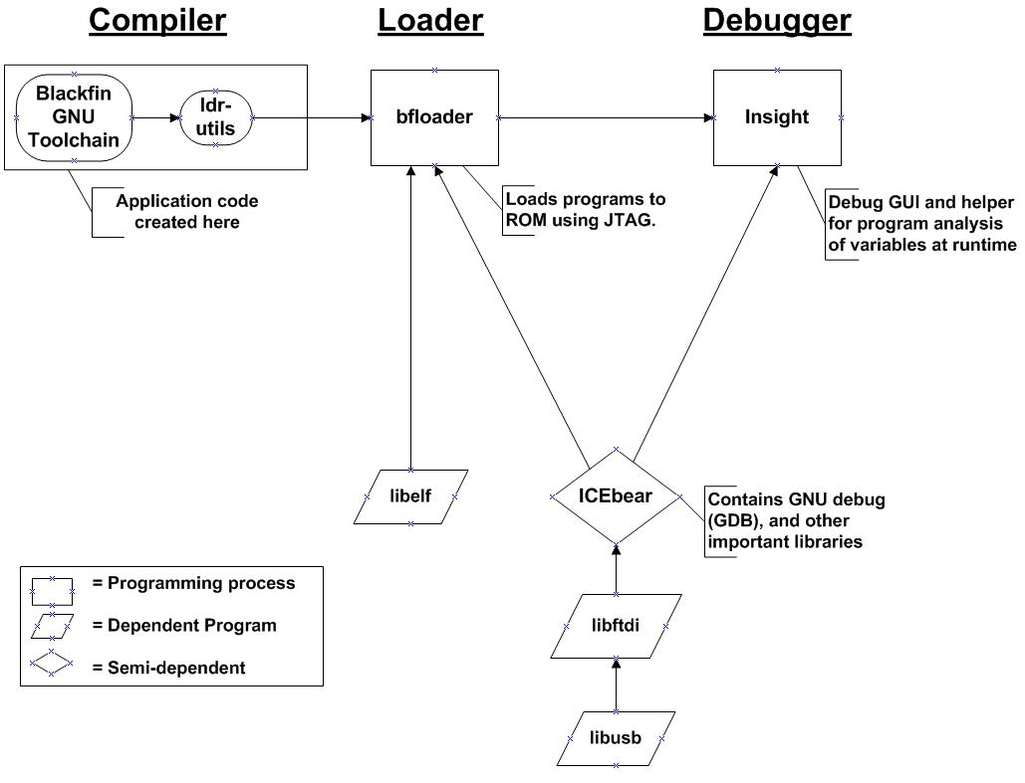
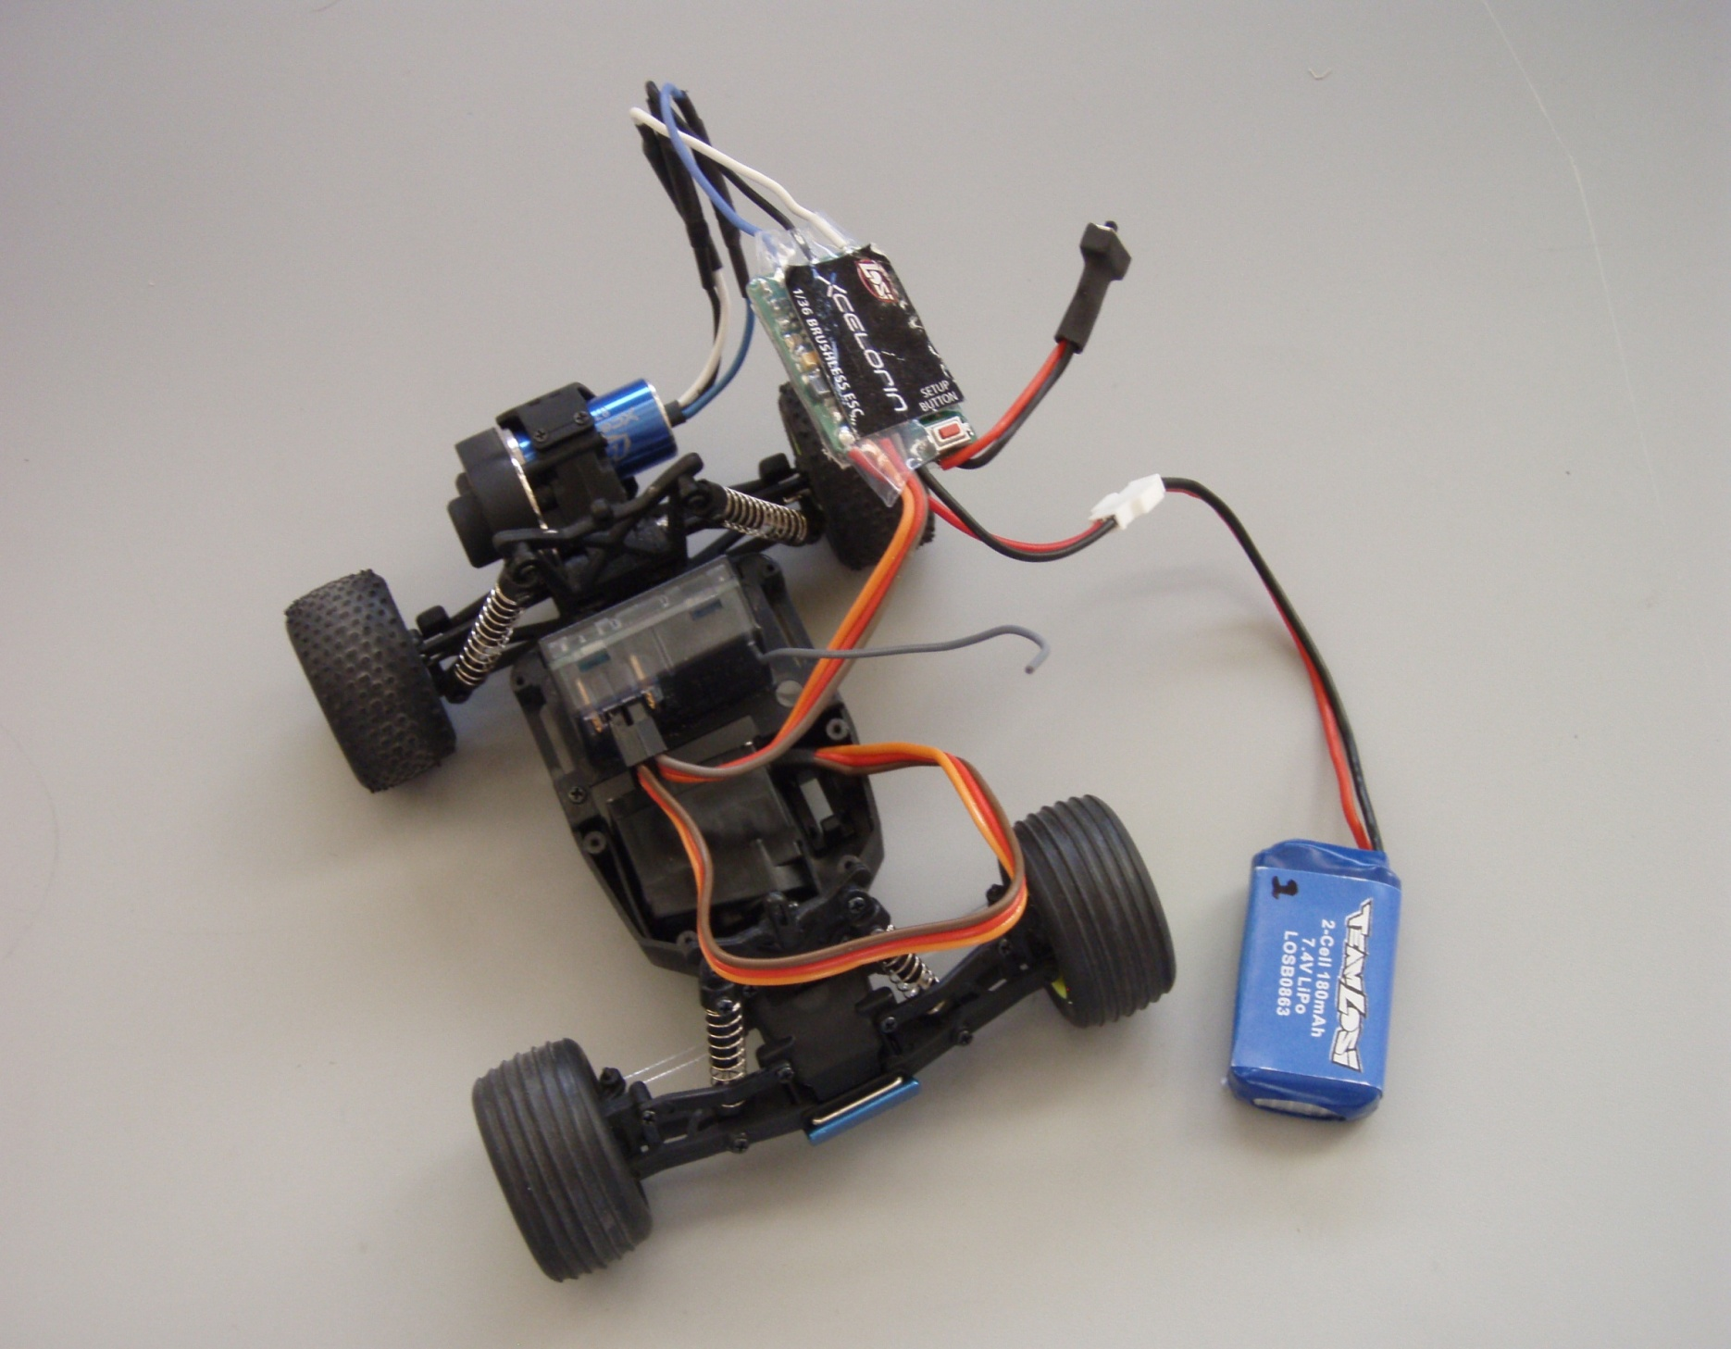
TOWARDS A LIGHTWEIGHT, HIGHLY CAPABLE MOBILE GROUND-BASED AGENT AS A RESEARCH PLATFORM FOR EXPERIMENTAL ARTIFICIAL INTELLIGENCE
Gabriella Geletzke
University of Tulsa Undergraduate
Aditya Mahadevan
Texas A&M Undergraduate
Brett Sutton
Texas A&M Undergraduate
Aaron Hill
Texas A&M Graduate Student
Dr. Takis Zourntos
Texas A&M Faculty Advisor
Abstract
The objective of our research project is to develop a lightweight mobile autonomous robot that approaches the level of capability and efficiency of biological agents to function as a test bed for novel paradigms of behavioral control (cognition). Swarms of these small robots could replace large, expensive robots as a more effective, economical solution in applications such as search and rescue, surveillance, and planetary exploration. To build our robot, we transform a small remote-controlled vehicle into a lightweight chassis by measuring the pulse width modulated control signals and replicating them on a digital signal processor (DSP) for autonomous control using C-language programs. In order to easily program the DSP, we develop an infrastructure for communication between a computer and the DSP. Additionally, we interface a compass module, two ultrasonic distance sensors, and a tri-axis accelerometer with the DSP to increase the maneuverability of the robot. The result is a highly effective and capable research platform for experimental artificial intelligence.
Introduction
Objective: to develop an autonomous mobile robot to be used as a test bed for lightweight artificial intelligence (AI)
First goal: develop an interface between a computer and a digital signal processor (DSP) in order to create a highly efficient, easily programmable, capable cognition for the robot
  System should allow for large range of sensors to be attached and programmed
Second goal: develop a small, lightweight chassis to hold the DSP and test algorithms
  Remote-controlled car is autonomous when DSP is mounted
Background
Robotic applications: planetary exploration, surveillance, search and rescue
Problem: modern robots do not compare in capability and efficiency of biological agents
  Example: Bees → lightweight, low power systems that seek targets, avoid obstacles, build nests, and communicate
Swarms of small autonomous robots could be a more effective, economical solution than a single large robot
Diverse research approaches to better robots
  Physical biological mimicry → snail, gecko, fly, bat , cockroach
  Sensing → bomb disposal, casualty detection, surveillance and reconnaissance
  Artificial intelligence →environment mapping, cooperation between multiple robots, obstacle avoidance, and target seeking
Survey of Modern Robots
Robot | Lab | Year | Autonomy | Mass | Physical Biomimicry | Comments
Test Bed | TAMU | 2008 | Yes | 142 g | n/a | Team Losi Micro-T chassis with Blackfin DSP to function as test bed for new AI
Stickybot | Stanford | 2008 | Yes | 370 g | Gecko | Artificial feet utilize van der Waals forces to climb walls
RoboSnail | MIT | 2005 | Yes | 32 g | Snail | Exploits fluid properties of Laponite slime in a way similar to marine snails
Morphing Micro Air and Land Vehicle | Case Western Reserve | 2008 | Semi | 120 g | Bat, Cockroach | Stealthy, maneuverable, successfully transitions from flying to walking
Robot Flea | UC Berkley | 2007 | Yes | mg | Flea | Solar-powered, jumps 30 times its height
Spirit Rover | NASA | 2008 | Yes | 118 kg | n/a | Explores Mars
The Swarm | MIT | 2008 | Yes | kg | n/a | Many robots (10 - 10,000) coordinate to accomplish tasks
Flying Insect | Harvard | 2008 | No | 60 mg | Fly | Uses small-scale aerodynamics by replicating wing trajectories of real fly
A combination of high levels of capability and efficiency (size, power consumption) rivaling that of biological agents would allow robots to accomplish a far greater range of tasks autonomously at a smaller cost
Desktop to Microchip Interconnection
Sensors
Development System
Chassis
Ultrasonic Distance Sensor
Emits ultrasonic waves and measures time taken for them to return
Longer time = longer distance
Outputs a pulse whose width corresponds to distance measured
Accelerometer
Compares position acceleration with gravitational acceleration in three axes x,y,z
Returns 12 bits of data for each axis
Measures up to ±3.3g in any direction
Detects free fall
Compass Module
Returns direction that module is facing
Generates voltage proportional to magnetic field in x, y axes
Returns voltage for each axis as 11 bits, one by one
Team Losi Micro-T
Size: 114 mm x 89 mm
Mass: 142.1 g
Turning radius: 19 cm
Electronic Speed Control (ESC)
Power Switch
Throttle servo
Remote control receiver
(replaced by SRV-1 board)
SRV-1 board
Steering servo
LiPo Battery
Pulse Width Modulation
Control Signals
Conclusion and Future Work
References
Voltage
Results
DSP can communicate with a range of types of sensors because the DSP supports multiple protocols
DSP handles multiple sensors simultaneously
DSP has built-in support for manipulating servos with PWM
Low power consumption, high processing speed
Use of C language allows for many different types of algorithms to be tested
Easily maintained and improved because individual components are commercially available
Further Research
Implement an algorithm based on nonlinear dynamics
Interface new sensors (light, sound, touch, heat)
Find more efficient way to implement new algorithms in C or other language
Lighten chassis, improve motors
Bergbreiter, S.; Pister, K.S.J., "Design of an Autonomous Jumping Microrobot," Robotics and Automation, 2007 IEEE International Conference on , vol., no., pp.447-453, 10-14 April 2007.
Boria, F.J.; Bachmann, R.J.; Ifju, P.G.; Quinn, R.D.; Vaidyanathan, R.; Perry, C.; Wagener, J., "A sensor platform capable of aerial and terrestrial locomotion," Intelligent Robots and Systems, 2005. (IROS 2005). 2005 IEEE/RSJ International Conference on , pp. 3959-3964, 2-6 Aug. 2005.
Chan, Brian; Ji, Susan; Koveal, Catherine; Hosoi, A. E., "Mechanical Devices for Snail-like Locomotion," Journal of Intelligent Material Systems and Structures, 2007 vol. 18, pp. 111-116, 2007.
Santos, D.; Heyneman, B.; Sangbae Kim; Esparza, N.; Cutkosky, M.R., "Gecko-inspired climbing behaviors on vertical and overhanging surfaces," Robotics and Automation, 2008. ICRA 2008. IEEE International Conference on , pp.1125-1131, 19-23 May 2008.
McLurkin, J; Smith, J; Frankel, J; Sotkowitz, D; Blau, D; Schmidt, B, "Speaking Swarmish: Human-Robot Interface Design for Large Swarms of Autonomous Mobile Robots," AAAI Spring Symposium, 28 Mar. 2005.
Wood, R.J., "The First Takeoff of a Biologically Inspired At-Scale Robotic Insect," Robotics, IEEE Transactions on , vol.24, no.2, pp.341-347, April 2008.
Image Credits:
http://www.surveyor.com/
http://blackfin.uclinux.org/
http://www.hobbyengineering.com/
Pulse width
Time
Time
Signal period
PWM is a technique to control servo motion
Fixed-frequency signal with varying pulse width
Width determines magnitude mechanical properties such as rotation speed or turn angle
Max Left
Max Right
Max Reverse
Max Forward
Department of Electrical and Computer Engineering
Texas A&M University
College Station, TX 77843-3128
Electrical Engineering Research Applications to Homeland Security
National Science Foundation Research Experiences for Undergraduates

